Slide 1
NFCC CAD and ICCS Supplier Engagement Day
Afternoon open Session : 13:00 – 17:00

Slide 2
Agenda – Afternoon session
Item | Activity | Time | Lead
1 | Welcome, introductions and apologies | 13:00 | Sally Conquest
2 | Purpose of today’s session and overview of team National Procurement Hub NFCC Ops Communications Strategy Board | 13:10 | Sally Conquest / Ian Taylor / Chris Else
3 | Fire Commercial relationship from a suppliers perspective | 13:30 | Frequentis
4 | Cloud/Hosted systems | 13:55 | Motorola
5 | Complexities of Systems integration | 14:20 | Saab
 | Comfort Break | 14:45
6 | Panel Discussion Market Forces / Financial impact / Risks MAIT Market development Specifications GD92 / Open Standards Information Intelligence | 15:00 | All
7 | AOB next steps and Close | 16:30 | Chris Else

Slide 3
Housekeeping
Permission to record? Slides and recording shall be made available;
Please keep all microphones off during this presentation, unless you are speaking;
Please raise any questions in the chat bar, or enter a ? into the chat bar, and we shall come to you in turn at the end of each slide;
During supplier presentations, opportunities shall be given at the end to ask any questions.

Slide 4
Purpose of Todays Session
Currently a number of Fire Services looking to go out to market for a CAD/ICCS solution the coming 24 months
Share FRS lessons learned from both previous tenders and engagement with suppliers
Two way feedback from suppliers :
Roadmaps;
Engagement;
Specifications
Discuss number of current market and sector issues :
CMA Investigations;
ESN/DCS;
Financial pressures.
Create a better future:
FiReControl project abandoned 2010
Most services reorganise and contract for 10 years plus
This day is about the next 5,10, 20 years
The start of an improved and closer relationship between the fire service sector and suppliers to collectively drive innovation that saves lives and protects people from harm.
Notes:
Please can I remind all supplier that this is a supplier agnostic engagement day to understand the supply market for CAD/ICCS as a whole. This is the start of engagement, and future sessions shall provide opportunities for any sales pitches.

Slide 5
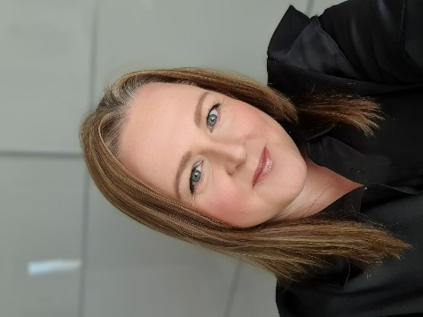
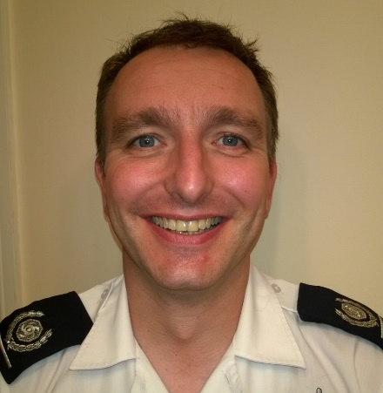
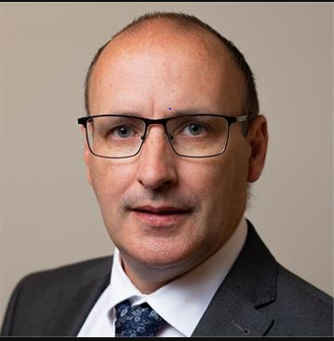
About the Team
Sally Conquest
National ICT Category Lead – National Procurement Hub
Ian Taylor
Senior User and Business Change Lead (Fire) for the National Fire Chiefs Council (NFCC)
Emergency Services Mobile Communications Programme
Chris Else
Assistant Director Resilience – Kent Fire and Rescue Service
Member of NFCC Ops Communication Strategy Board and lead on supplier engagement

Slide 6
Commercial Overview
Mission of the NFCC Procurement Hub:
“To support the goals and diversity of the Fire & Rescue service through the delivery of transparent and inclusive collaborative opportunities that provide optimum value to end users and the public purse.”
https://www.nfcc-procurementhub.org.uk/
Key Principles –
Standardised requirements;
Aggregated volumes;
Collaboratively managed contracts and suppliers;
ICT Category Lead role – Current project priorities
Multi Agency Incident Transfer (MAIT);
ESN;
Collaborative Police and Fire e-procurement system and contracts database;
Supporting delivery of Key Priority 7 for OCSB;
Hardware/software collaboration across the sector.
Notes:
Vision The vision of the NFCC is to improve safety in communities by working collaboratively with fire and rescue services, promoting national approaches where they work best. Procurement is a vital part of this collaborative intent
NFCTP – formed in 2016 in response to the fire ministers reform agenda, chaired by Ann Millington, Chief Exec of KFRS. Consists of 6 Chief Fire Officers/Chief Execs category sponsors, and six cat leads from across the sector – ICT, Fleet, Ops, FM/Property, Professional Services and PPE/Clothing

Slide 7
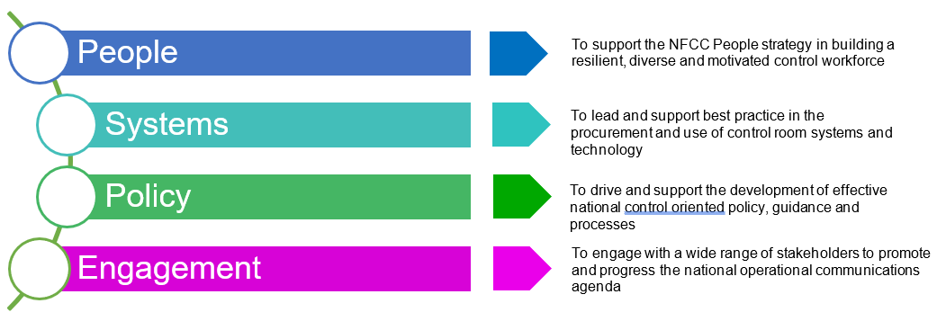
Operational Communications Strategy Board
Note: Chair of OCSB is Ben Norman – Deputy Chief Fire Officer Greater Manchester Fire and Rescue
Notes:
Operational Communications Strategic Board - Purpose and structure
The OCSB is formed to bring together expertise related to fire and rescue emergency control rooms and operational communications and is intended to provide an intelligent client function overseeing operational communications matters on behalf of the Fire and Rescue Service. The purpose of the Board is to identify and share good practice in both specification and operation of control room systems and to ensure that FRS have access to, and can use, effective operational communications systems. It will promote consistently high standards of operational performance throughout the UK FRS. The Board will also provide oversight for national projects or programmes related to control provision, for example development of guidance for the operation of control rooms being developed under the Fire Control Guidance project, Firelink and the Emergency Services Mobile Communications Programme.
The Board, in conjunction with the Mobilising Officers Group (MOG) as the subject matter experts, will advise NFCC National Ops Coordination Committee, via the NFCC Strategic Lead for Operational Communications, on matters relating to Fire Control functions.
The OCSB will ensure that all matters related to the effective operation of fire and rescue emergency control rooms are considered. The MOG will provide subject matter expertise for operational matters in particular.
Working groups constituted under the OCSB will be for specific, time limited projects or tasks and will define their own meeting patterns. Working groups will define their terms of reference based upon the scope set by the OCSB and present them to the board for approval.
Chair is Ben Norman Deputy Chief Greater Manchester Fire and Rescue Ben Norman - Greater Manchester Fire Rescue Service

Slide 8
Operational Communications Strategy Board
Key Priority 7 – “Control room system suppliers monitoring and high level national business requirements for control room systems and equipment”;
Aims and Intended outcomes;
Increase sector situational awareness and understanding;
Leading to greater levels of efficiency, intelligence and consistency of fire service control rooms;
Allow future technology to be more easily and more efficiently implemented across the sector;
Notes:
Aim - Development of a central national record of control room supplier and equipment information maintained and accessible to FRS.
An agreed set of high level business requirements, that detail the minimum viable set of requirements for CAD, ICCS and associated control room systems.
Outcomes: This information is intended to increase sector situational awareness and understanding leading to greater and levels of efficiency, intelligence and consistency of fire service control rooms.
It will also allow future technology to be more easily and more efficiently implemented across the sector. Need to consider integration and interoperability also.
This day is intended as the start of a refreshed relationships with suppliers -

Slide 9
Supplier Presentation
Fire commercial relationship from a suppliers perspective
Frequentis – Dave King

Slide 10
Supplier Presentation
Cloud / Hosted Systems
Motorola – Yann Marston

Slide 11
Supplier Presentation
Complexities of Systems Integration
Saab – Alan Hall

Slide 12
Break Time!

Slide 13
Round up….
Round up on pre-break presentations
Notes:
Invite suppliers not involved in presentations if they wish to add anything

Slide 14
Virtual Panel Discussion
Reminder: Panel Housekeeping
Please keep all microphones off during this presentation unless you are speaking;
Please raise any questions in the chat bar, or enter a ? into the chat bar, and we shall come to you in turn at the end of each slide.
Panel:
We would like each supplier to be given an opportunity to respond to each question in turn, on behalf of their own organisation;
Nominated speakers for each organisation shall facilitate a response, and pass over to a colleague if required.

Slide 15
Virtual Panel Discussion
Motorola – Yann Marston
SSS – Andy Kerr
Frequentis – Stephen Halley
Hexagon – Ian Holmes
Sopra Steria – Gary Stuart
Saab – Alan Hall

Slide 16
Thanks and suggested next steps
Thank you to all the Fire service representatives and suppliers for their engagement and support
Thank you to Sally Conquest for doing such a great job organising the event
Next steps
Please provide feedback on the day and any thoughts for future events
Organising team will report back to OCSB and the NFCC on the findings and thoughts from the day
Due to significant change in the sector we propose future regular supplier events:
½ day workshop events every 6 months up until 2025 and every year after that;
Expansion of suppliers we engage with to include other suppliers that provide systems and support to fire control rooms and services, including consultants and developers;
Potential for event to include integrated services – thoughts?;
Next event estimated June 2023.

